Slide 1






[[ ]]
Data Analysis with Python
import
Team Project: Diabetes Health Indicator
Exploring patterns and interactions between demographic, physiological, and lifestyle factors in diabetes prevalence
{ }
def()
Presented by:
MISS OTEMA & MISS KWEYAKIE

Slide 2


















Project Background and Motivation
Diabetes Overview
Factors Influencing Diabetes
Chronic metabolic condition characterized by impaired glucose regulation
Long-term health complications including cardiovascular disease, kidney damage, and nerve dysfunction
Biological
Behavioral
Genetic predisposition and biological factors
Lifestyle choices and health behaviors
Prevalence influenced by a combination of biological, behavioral, and environmental factors
Environmental
Interactions
Study Motivation
External factors and surroundings
Complex relationships between factors
Increasing availability of large-scale health survey data enables population-level analysis
This project applies data analysis techniques using Python to explore diabetes prevalence across a wide range of health and lifestyle indicators
Focus on understanding complex, interacting patterns rather than isolating single explanatory factors

Slide 3











Research Objectives
This study aims to understand diabetes prevalence through four key objectives:
1
2
Explore Prevalence Across Variables
Identify Subgroup Variations
Examine diabetes prevalence across demographic, physiological, and lifestyle variables
Identify how diabetes prevalence varies within and across population subgroups
3
4
Analyze Interactions Between Factors
Foundation for Predictive Modeling
Analyze interactions and cumulative effects between multiple risk factors
Provide analytical foundation for future predictive modeling and risk assessment
This research emphasizes comprehensive pattern exploration rather than isolated factor analysis

Slide 4















Research Question
How does diabetes prevalence vary across different groups and behaviors?
Demographic Groups
Body Composition
Lifestyle Behaviors
Age groups
BMI categories
Physical activity levels
Other demographic characteristics
Physical composition metrics
Smoking status
Comprehensive Pattern Exploration
This research question emphasizes comprehensive pattern exploration and avoids reducing diabetes risk to a limited set of variables.
Patterns emerge from interactions between factors

Slide 5










Dataset Overview
Dataset Scale
The dataset contains 253,680 individual records, each representing a unique participant in a health survey.
This scale enables robust identification of population-level trends and detailed subgroup analysis.
Variable Categories
Demographic Characteristics
Anthropometric Measures
Age groups and demographic breakdown
BMI (Body Mass Index) categories
Lifestyle Behaviors
Health Indicators
Physical activity levels
Self-reported health conditions
Smoking status
Clinical diabetes indicators

Slide 6
























Data Preparation and Quality Control
Prior to analysis, the dataset underwent rigorous preprocessing to ensure data quality and reliability of observed patterns.
Raw Data
Missing Value Handling
Validation
Standardization
Analysis Ready Data
Missing & Inconsistent Values
Variable Validation
Identification and handling of missing or inconsistent values to ensure data integrity.
Validation of variable ranges and distributions to ensure data accuracy.
Standardization
Analysis Preparation
Standardization of categorical variables for consistent analysis.
Data preparation for group-based and visual analysis.
Why this matters: These steps ensure observed patterns are reliable and not artifacts of poor data quality.

Slide 7






















Feature Engineering and Analytical Metrics
Enhancing Analytical Depth
To improve analysis, we created new variables that capture complex relationships and simplify interpretation.
Derived Metrics
Analytical Value
Multidimensional Risk Capture
Obesity Status
Characterizes risk across multiple dimensions simultaneously
Calculated using standard BMI thresholds
Cross-Group Comparison
Normal: BMI < 25
Overweight: 25 ≤ BMI < 30
Enables meaningful comparisons across diverse population groups
Obese: BMI ≥ 30
Cumulative Pattern Interpretation
Composite Risk Score
Supports understanding of how risks accumulate and interact
Integrates multiple factors into a single metric
Enhanced Detection
Age
BMI
Physical Activity
Reveals patterns that might be missed by single-factor analysis
These metrics transform raw data into actionable insights for population health analysis

Slide 8


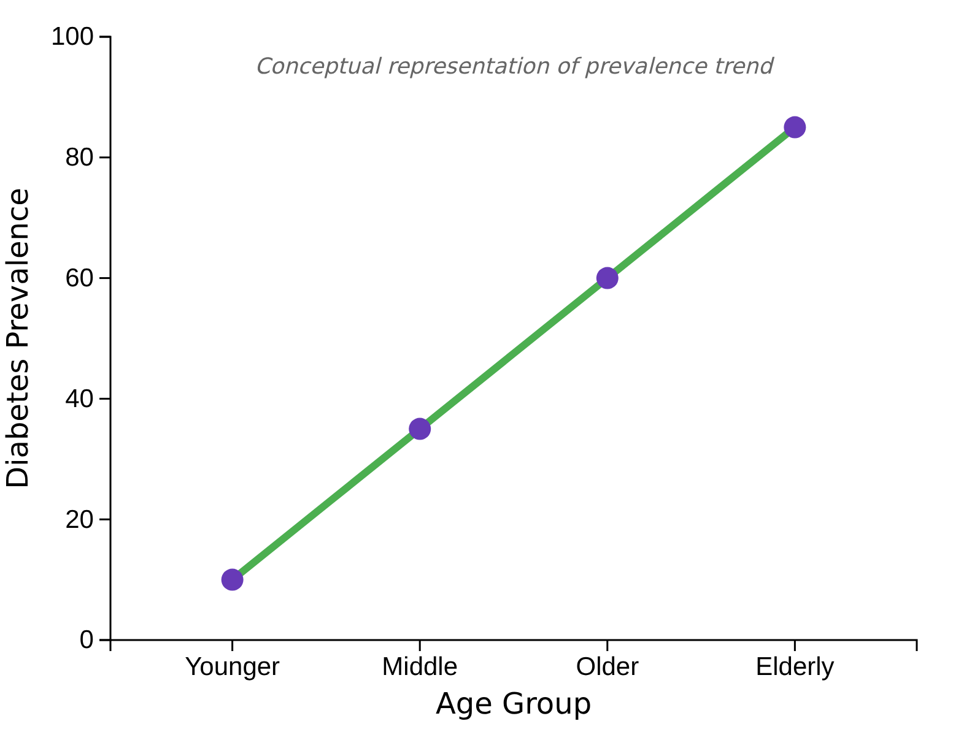







Age Structure and Diabetes Prevalence
Prevalence by Age Group
Observed Patterns
Lowest prevalence among younger individuals
Gradual increase across middle-aged groups
Marked increase among older age categories
Key Interpretations
Risk Accumulation
Diabetes risk accumulates over time due to prolonged exposure to metabolic stressors
Amplification Effect
Age amplifies the impact of other risk variables such as BMI and physical inactivity
Trend shows increasing diabetes prevalence with age

Slide 9


















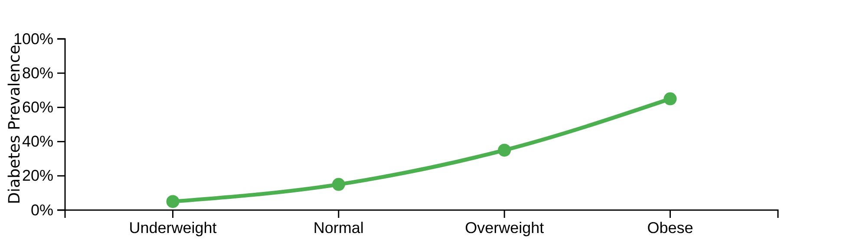


BMI Distribution and Weight-Related Patterns
Key Observ observations
BMI Categories
Progressive Increase
Normal Weight
Diabetes prevalence increases progressively across all BMI levels
Population Distribution
High concentration in overweight and obese BMI categories
Overweight
Higher Vulnerability
Higher BMI categories show greater vulnerability to diabetes
Visualization of BMI Patterns
Obese
Interpretation
These findings highlight the role of excess body weight in metabolic dysregulation. Higher BMI categories show greater vulnerability to diabetes, especially when combined with other risk factors.

Slide 10

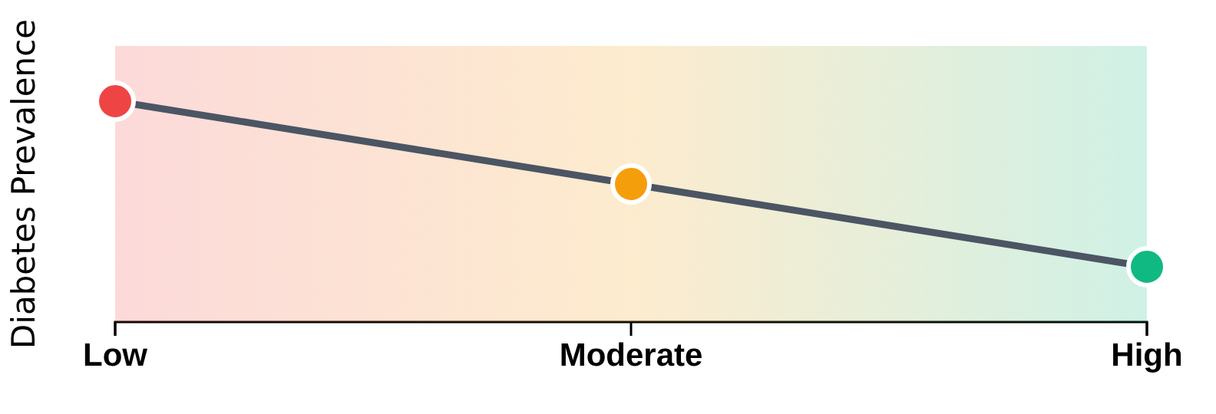













Physical Activity Gradient
Activity-Prevalence Gradient
Observed Patterns
Diabetes prevalence decreases as physical activity increases
Physical activity improves insulin sensitivity and metabolic health
Key Insights
Protective Effect
Physical activity exerts a protective effect against diabetes
Low Activity
Moderate Activity
High Activity
Gradient Relationship
Even moderate increases in activity can reduce diabetes risk
Highest prevalence
Lowest prevalence
Intermediate prevalence

Slide 11
























Smoking Behavior and Diabetes
Impact Pathways
Observed Patterns
1
2
Diabetes prevalence varies across smoking categories
Metabolic Health
Cardiovascular Health
Smoking interacts with other lifestyle behaviors
Insulin resistance
Glucose intolerance
Reduced blood flow
Combined exposure to smoking and physical inactivity corresponds to higher prevalence
Weight gain
Increased inflammation
Endothelial dysfunction
3
4
Key Insight:
Lifestyle Interactions
Risk Amplification
Smoking contributes indirectly to diabetes risk by influencing metabolic and cardiovascular health and by interacting with other lifestyle factors.
Smoking + physical inactivity
Reduced physical activity
Unhealthy eating patterns
Metabolic + cardiovascular
Lower health awareness
Multiple adverse factors
Smoking behavior represents a significant modifiable risk factor for diabetes, particularly when combined with other lifestyle behaviors.

Slide 12


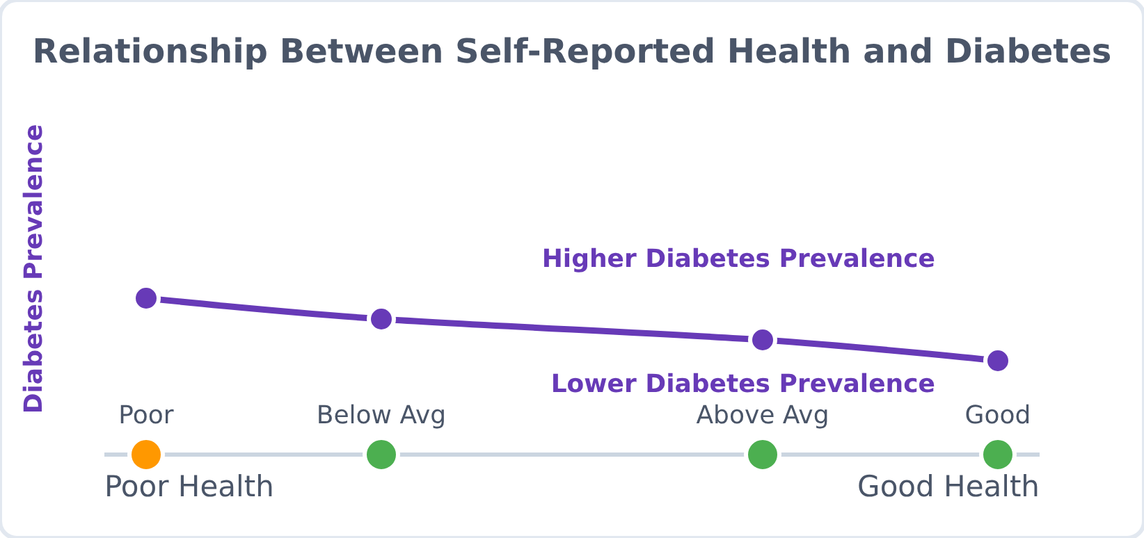











Self-Reported Health and Clinical Indicators
Observed Patterns
Health Indicator Relationship
Poorer self-reported health correlates with higher diabetes prevalence
Multiple adverse health indicators tend to cluster in individuals with diabetes
Diabetes prevalence increases as overall health status declines
Key Insight
These patterns suggest that diabetes often coexists with broader health deterioration, reinforcing its role as part of a larger metabolic syndrome.
Kidney Function
Cardiovascular
Neurological
Understanding these relationships helps develop more comprehensive treatment approaches

Slide 13


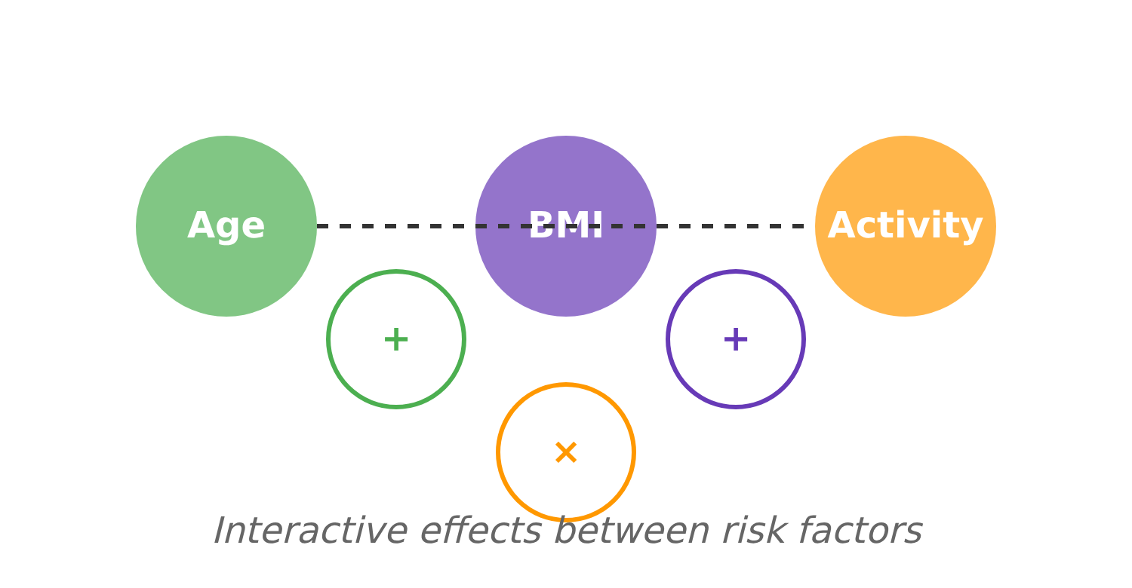








Cumulative and Interaction Effects
Key Observations
Interaction Effects Visualization
Diabetes prevalence increases sharply when multiple risk factors are present
Age, BMI, and lifestyle behaviors interact rather than acting independently
Analysis Insights
The interaction between variables highlights the importance of multivariable analysis
Understanding interaction effects is crucial for developing comprehensive intervention strategies
Interaction Effects Explained:
Age + BMI
Age + Activity
BMI + Activity
Age + BMI + Activity

Slide 14
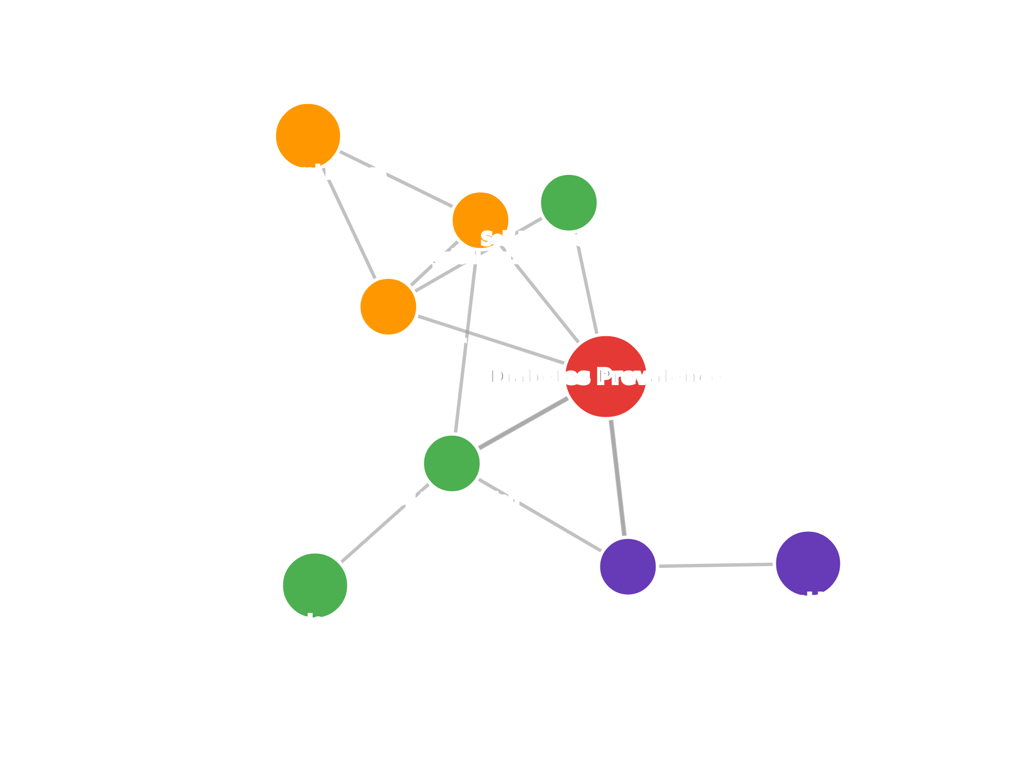








Overall Pattern Synthesis
The analysis reveals a network of interconnected patterns linking diabetes prevalence to demographic, physiological, and behavioral indicators. Rather than a single dominant cause, diabetes prevalence emerges from the accumulation and interaction of multiple risk factors across the population.
Key Synthesis Insights
Interconnected Factors
Patterns observed are interconnected rather than independent, with each factor influencing and amplifying others
Cumulative Effects
Risk accumulation over time, with age amplifying the impact of other risk variables such as BMI and physical inactivity
Holistic Risk Assessment
Single-factor analysis underestimates overall risk; comprehensive approach needed for accurate assessment

Slide 15



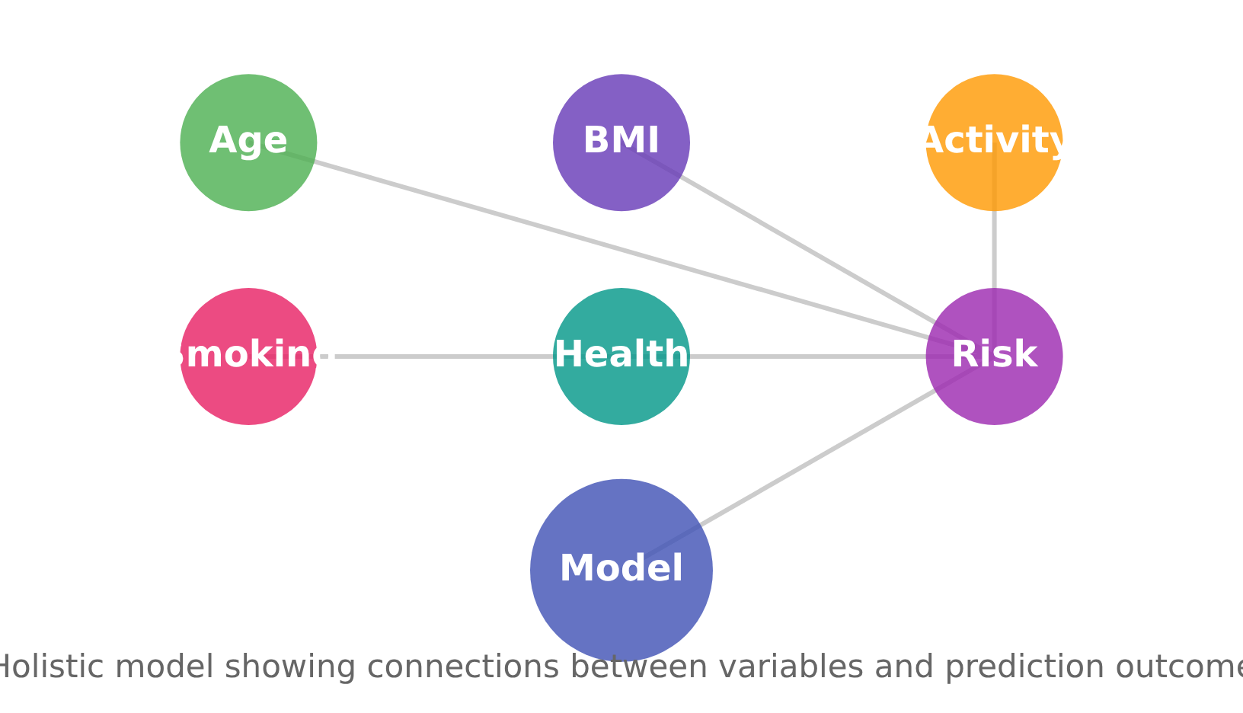






Implications for Predictive Modeling
Multiple Variables
Holistic Modeling Approach
Predictive models should incorporate multiple variables including demographic, physiological, and behavioral indicators rather than relying on single-factor approaches.
Interaction Effects
Modeling interaction effects between variables provides more accurate risk assessments than assuming independent contributions of each factor.
Derived Metrics
Key Benefits of Holistic Modeling:
Composite metrics like obesity status and risk scores enhance risk stratification and simplify comparison across population groups.
Improved accuracy in risk prediction
Enhanced interpretability of risk factors
Better identification of high-risk individuals

Slide 16



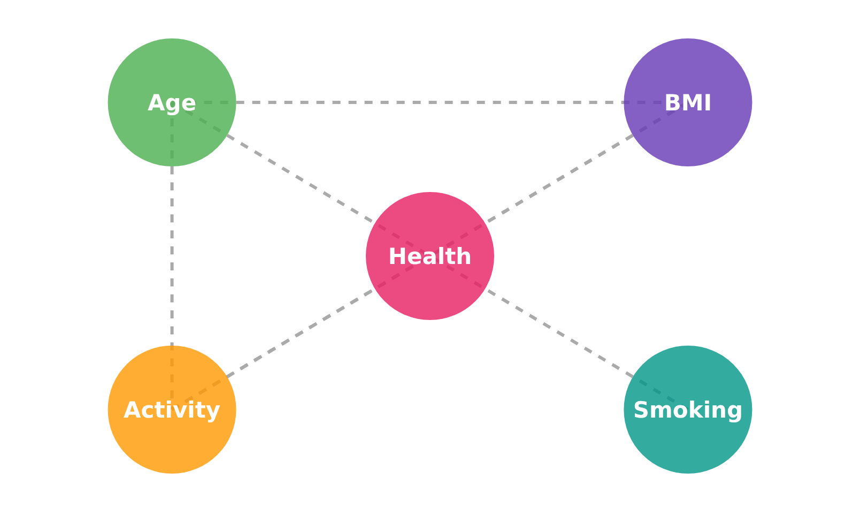



Conclusion
Key Insight
Interconnected Patterns
This study demonstrates the value of comprehensive pattern analysis in understanding diabetes prevalence. By examining all observable patterns, the analysis provides a nuanced and realistic view of diabetes risk within the studied population.
Comprehensive Analysis Value
Captures multidimensional risk profiles across demographic, physiological, and behavioral indicators
Diabetes prevalence emerges from the accumulation and interaction of multiple risk factors across the population
Reveals interactions and cumulative effects between multiple risk factors
Provides foundation for future predictive modeling and risk assessment

Slide 17












Recommendations
Based on our analysis of diabetes prevalence patterns, we propose the following strategic recommendations:
Promote Physical Activity
Targeted Interventions
Implement community-wide initiatives to increase physical activity levels, particularly in middle-aged and older adults who show the highest diabetes risk. Create accessible fitness programs tailored to different age groups.
Develop customized intervention programs for high-risk population groups identified through our analysis, particularly focusing on middle-aged adults with overweight/obesity and low physical activity levels.
Integrated Monitoring
Data-Driven Policy
Encourage comprehensive tracking of both lifestyle behaviors and health indicators to provide a holistic assessment of diabetes risk. Implement screening programs that consider multiple risk factors simultaneously.
Use data insights to inform public health policy development. Create decision-support tools that incorporate our findings on interaction effects between risk factors to optimize resource allocation and intervention strategies.
Thank you for your attention

